Slide 1
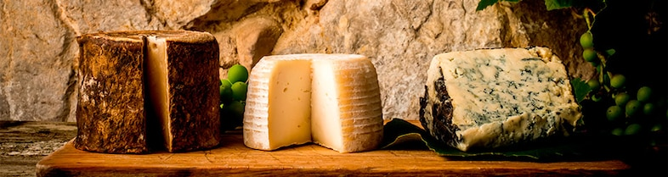
CHEESES IN THE WORLD
ANALYSIS OF THE CHEESE INDUSTRY
by Marie Lourdes Corti

Slide 2
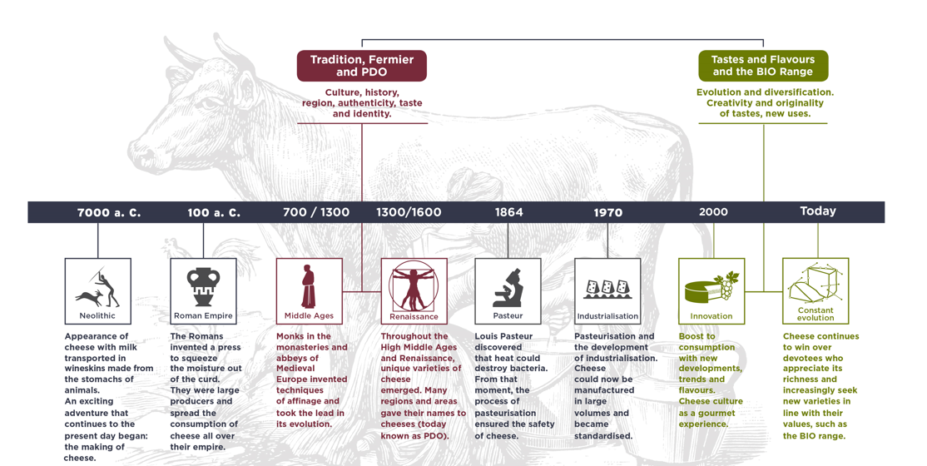
BRIEF HISTORY OF CHEESE

Slide 3
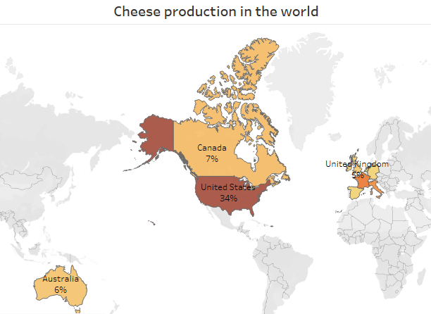
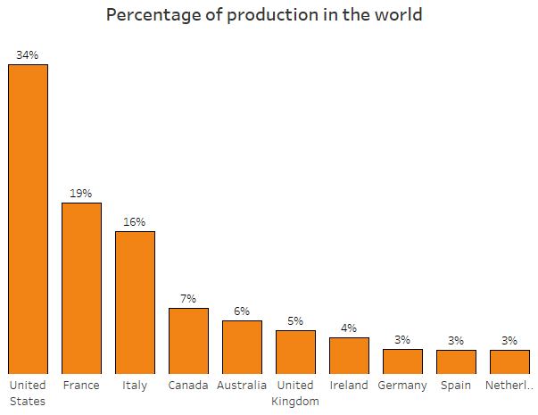
CHEESE PRODUCTION IN THE WORLD
SITUATION
The distribution of cheese production by country is important to understand which are the producing countries and type of production.
TASK
Using Tableau, determine the data of the selected dataset, using filters to highlight the main ones.
ACTION
Build two graphs to see the distribution of production by country, applying the top ten filter to highlight who the largest producers are.
RESULT
We can visualize in the two graphs that the countries with the highest production are United States, France and Italy.

Slide 4
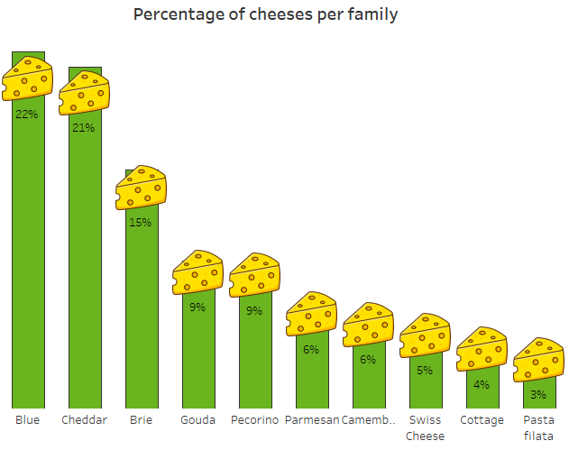
TYPES OF CHEESE
Question: What are the most produced types of cheese in the world?
SITUATION
The distribution of production by types of cheese is important to understand which cheeses are produced and to be able to visualize subsequent analyses.
TASK
Visualize the distribution of production of each type of cheese.
ACTION
Build a graph to analyze the production percentage of each cheese.
RESULT
We can see that the types of cheese that are most produced are Blue, Cheddar and Brie.

Slide 5
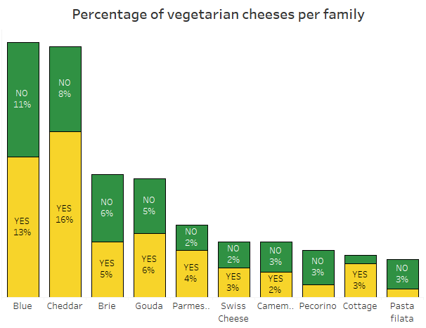
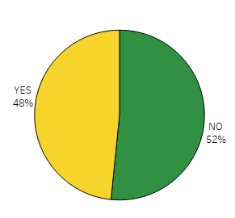
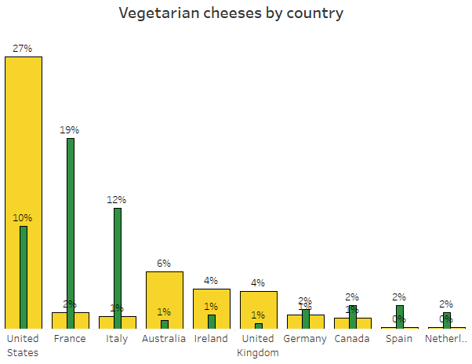
WHAT HAPPENS WITH THE VEGETARIAN CHEESES?
SITUATION
Currently, vegetarian cheeses are being produced due to the boom in demand for organic and vegetarian products.
TASK
Visualize the distribution of the production of vegetarian cheeses.
ACTION
Build three graphs to understand how this production is distributed.
RESULT
We can see that the largest production of vegetarian cheeses is in the United States, and that in France and Italy, the distribution is lower and the classic production tends to be preserved.

Slide 6
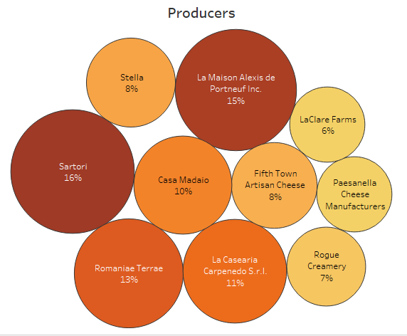
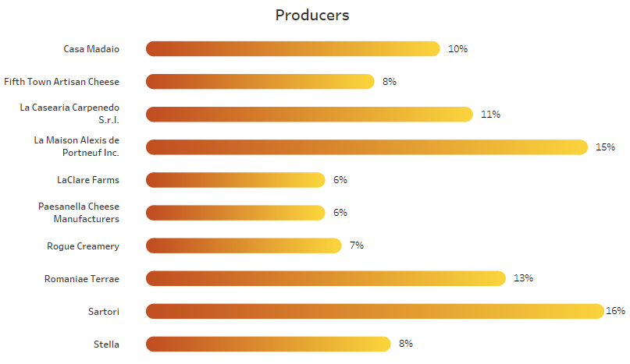
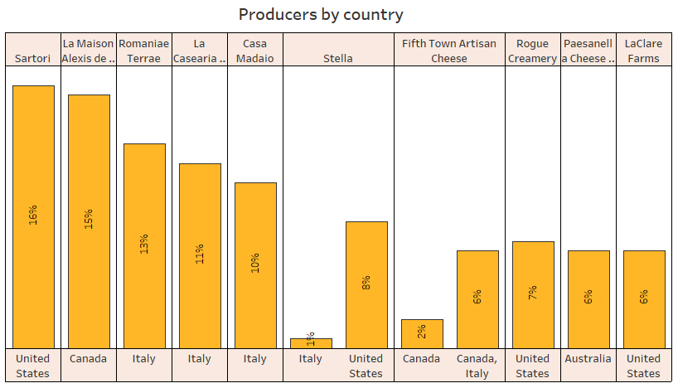
PRODUCERS
Question: Who are the largest cheese producers in the world?
To visualize who the largest producers are, three graphs are built in Tableau, and a filter is applied to determine the top ten producers and in which countries they are located.
The largest cheese distributors are Sartori and La Maison Alexis de Portneuf Inc, and they are located in the United States and Canada.

Slide 7

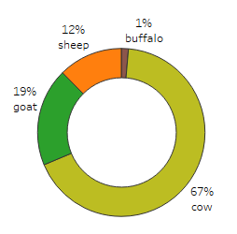
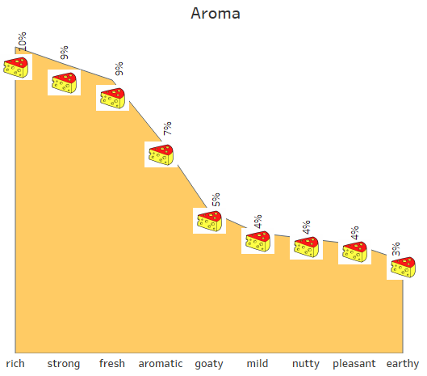
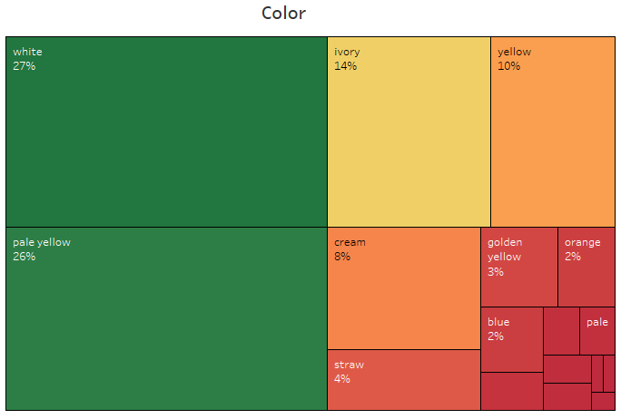
CHEESE CHARACTERISTICS
What are the characteristics of cheeses?
SITUATION
Cheese production is very varied, and depends on how it is done in each country and the demand for it according to its characteristics.

Slide 8
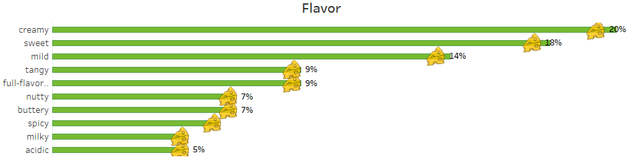
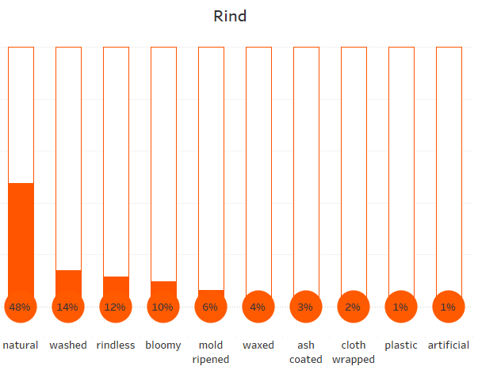
... MORE CHEESE CHARACTERISTICS
TASK
Determine the characteristics of the main types of cheeses that are produced.
ACTION
Construct five graphs to determine the characteristics of the following: flavor, color, milk used, rind and aroma.
RESULT
From the graphs constructed we can draw conclusions about the greater production of the main types of cheese.

Slide 9
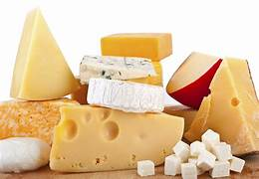
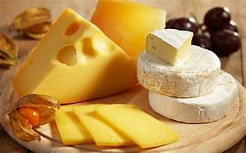
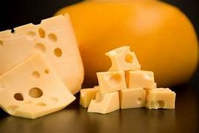
CONCLUSIONS:
The countries with the largest cheese production in the world are: the United States, France and Italy. The largest production companies are located in the United States, Canada and Italy.
The types of cheeses most produced in the world are Blue, Cheddar and Brie.
There is more and more production of vegetarian cheeses in the world. They are mainly produced in the United States, Australia, Ireland and Great Britain. In France, Italy, Spain, Holland, Canada and Germany, classical cheese production is chosen and almost no vegetarian cheeses are produced.
The cheese is mainly produced with cow's milk. The main aromas are: rich, strong, fresh and aromatic. The main colors are white and pale yellow.The main flavors are creamy, sweet and mil.Cheeses are mostly produced with natural rind.
REFERENCES:
History of cheese: https://www.iberconseil.es/en/cheese-professionals/cheese-culture/origin-history-cheese.htm
Dataset used: https://www.kaggle.com/datasets/umerhaddii/global-cheese-dataset

Slide 10
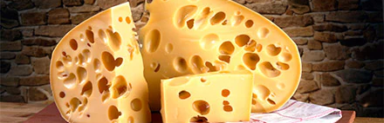
THANK YOU!!!

